Slide 1
Asian Restaurants in Toronto, Canada
Tracy E. Oliver
September 14, 2020

Slide 2
Toronto, Canada
Most populous city in the country of Canada
A city known for its international center of business, finance, arts and culture
The leading tourism destination in Canada, welcoming over 27.5 million visitors annually.

Slide 3
Problem
To eliminate last minute meal planning for Asian ( e.g. Chinese, Indian, Japanese) food by a visitor(s) to Toronto, CA, we have decided to come up with a way to identify the top restaurants based on their customer reviews and ratings.

Slide 4
Data Acquisition & Cleaning
Data sources used for this assignment came from the City Guide on Foursquare.com, with rankings ranging 1 to 10 by searching for Asian Restaurants in Toronto, CA.
Performed scraping techniques to retrieve the restaurant name, country, and rating data.

Slide 5
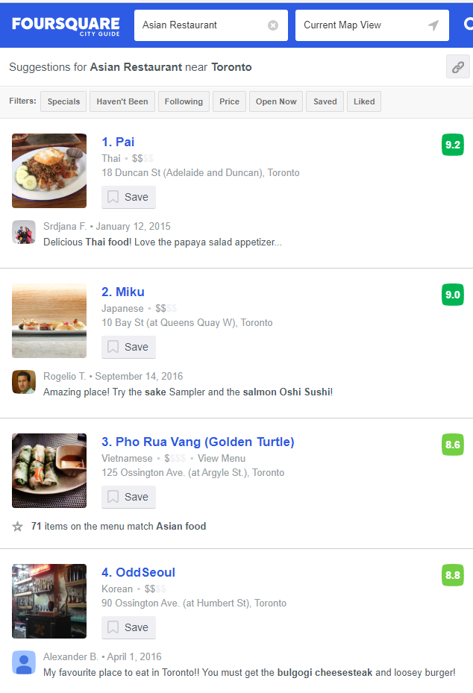

Slide 6
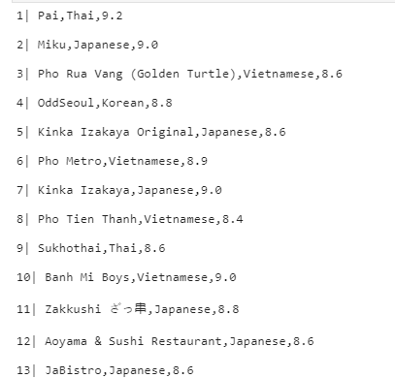

Slide 7
Conclusion
Retrieve the 30 restaurants and their ratings within Toronto, CA from the City Guide on Foursquare.com.
Unable to retrieve the Review data.

